Slide 1
LUL Youth Development and Education Project
JKL Systems

Slide 2
Overview
Team Introduction
Opportunity
To-Date Summary
Use Case and Diagram
Sequence Diagram
Class Diagram
ERD
ERD Table and Data Dictionary
User Interface Navigation
Physical Architecture Design
Security
Gantt Chart
Notes:
Okay so here is just a brief overview of what will be covered in the presentation. I wasn’t sure what to call the previous stuff we’ve covered, so if you wanna change the name of that section feel free.

Slide 3
Opportunity
Creating an efficient reporting process, by centralizing data, to increase funding from donations and grants.
Notes:
He asked us to restate the problem, so instead of calling it problem I went with opportunity

Slide 4
To-Date Summary
As-Is Model
Areas of Opportunity
System Requirements
To-Be Model
Performed a Feasibility Analysis
Business Value
Use-Cases
Notes:
We created the as-is model. Which is how their system looks today
-We’ve reviewed the areas of opportunity to see how their system could be improved
The system requirements are what they need their system to do.
-We then created a to-be model.
We preformed a feasibilty analysis to see if the new system should be built.
-Next we looked at the business value of the new system
The use cases describe the systems function from a high level view…
*I’m not sure if this is what you all meant. But I just touched on the high level of items we reviews and you can just give a brief synopsis of them.

Slide 5
Use Case Definition
Use Case: a simple description of a system’s function from a high level view
Notes:
This is the best definition I could think of for describing it in laymans terms. If anyone can think of something better feel free to change it

Slide 6
Generate Street Academy Enrollment
1. Use-Case Name – Generate Street Academy Enrollment
1.1 Brief Description
The Parent/Guardian, Program Assistant, or Youth Specialist enrolls student into the Street Academy Program.
2. Flow of Events
2.1 Basic Flow
1. The use case starts when a Parent/Guardian wants to enroll their child into the program.
2. If Parent/Guardian decides to enroll online
2.1 The system requests youth demographics, parent/guardian information, and additional youth information.
2.2 The Parent/Guardian provides the youth demographics, parent/guardian information, and additional youth information.
2.3 The system records the youth demographics, parent/guardian information, and additional youth information.
3. If Parent/Guardian decides to enroll on-site
3.1 Program Assistant/Youth Specialist requests youth demographics, parent/guardian information, and additional youth information.
3.2 The Parent/Guardian provides the youth demographics, parent/guardian information, and additional youth information.
3.3 The Program Assistant/Youth Specialist inputs into system youth demographics, parent/guardian information, and additional youth information.
3.4 The system records the youth demographics, parent/guardian information, and additional youth information.
4. Use case ends
2.2 Alternative Flows
None.
3. Special Requirements
None.
4. Pre-conditions
4.1 Pre-condition
The Street Academy Program has been created within the system.
5. Post-conditions
5.1 Post-condition One
The enrollee’s information has been recorded.
5.2 Post-condition Two
The Parent/Guardian receives confirmation their child has been enrolled, along with a schedule of the program.
6. Extension Points
6.1 Name of Extension Point
Extend: Update existing youth demographics, parent/guardian information, and additional youth information.
Notes:
Use Case 1: Generate enrollment

Slide 7
Use Case Diagram
Notes:
Use case diagram for enrolling student

Slide 8
Sequence Diagram Definition
Illustrates the objects (i.e. – Parent/Guardian, Program Assistant, etc.) that participate in a Use Case and the messages (i.e. – request enrollment) that pass between them over time.

Slide 10
Class Diagram Definition
Class Diagram: a static structure diagram that describes the structure of a system by showing the system's classes, their attributes, and the relationships between the classes.
Notes:
This is the best definition I could think of for describing it in laymans terms. If anyone can think of something better feel free to change it

Slide 11
Class Diagram Description
The classes will store and manage information in the system.
The diagram contains attributes of each class and methods.
Attributes are the properties we wish to capture information about and methods are behaviors that the class can perform.
Notes:
This was taken from kelli’s narrative.

Slide 13
ERD Definition
ERD (Entity Relationship Diagram): models the relationships between entities (tables) in a database.

Slide 14
Notes:
Okay so this covers up the title, but I think you can see it a lot better if its bigger.
-You can just kinda go through some of the tables maybe and the relationships.

Slide 15
ERD Description
An entity (table) is an object or concept, which stores data
A relationship is how the data is shared between entities.
The goals of an ERD are to eliminate redundancy and ensure data dependencies make sense.
Notes:
-this is from the ERD narrative. The entity sentence didn’t make a whole lot of sense to me so that description may not be right.

Slide 16
ERD Table
Notes:
Here is just an example of an entity. The data dictionary is on the next slide. Or I can combine them. Up to you?!

Slide 17
Data Dictionary
Here is an example of the data dictionary for the program entity:
PROGRAM
Key | Attribute | Definition | Max Data Size (in bytes) | Data Type
PK | PROGRAM_ID | UNIQUELY IDENTIFIES PROGRAM | 3 | ALPHANUMERIC
 | PROG_NAME | NAME OF PROGRAM | 15 | VARCHAR
 | DESCRIPTION | DESCRIPTION OF PROGAM (AND ACTIVITIES) | 100 | VARCHAR
 | STARTDATE | START DATE OF PROGRAM | 10 | DATE
 | ENDDATE | END DATE OF PROGRAM | 10 | DATE
 | CAPACITY | MAXIMUM NUMBER OF STUDENTS ALLOWED TO ENROLL | 2 | VARCHAR
 | LOCATION | PLACE WHERE PROGRAM BEING RUN (HELD) | 15 | VARCHAR
 | EMP_ID | IDENTIFIES EMPLOYEE (YOUTH SPECIALIST) RESPONSIBLE FOR RUNNING AND OVERSEEING PROGRAM | 5 | ALPHANUMERIC

Slide 18
User Interface Navigation
Notes:
Here is the navigation form…however I don’t know if we need this or not. You can fill free to delete it

Slide 19
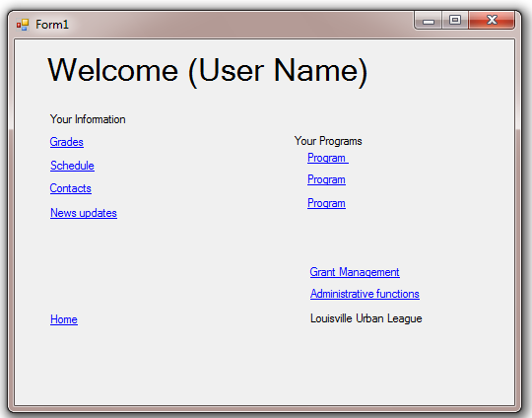
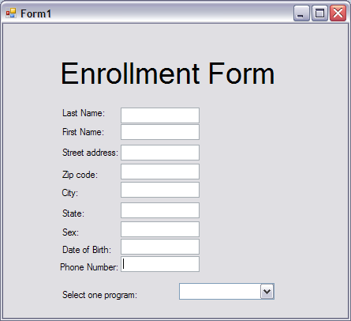
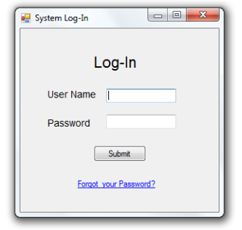
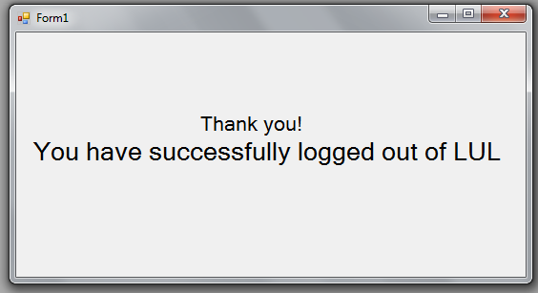
User Interface Navigation
Notes:
Okay so here is what I have… His narrative explains each of the forms.

Slide 20
Physical Architecture Design
We believe architecture is in place (client computers, office server, application server)
We feel no third party is needed to implement new system
Current architecture shall handle the control and security of data
Scalability should not be an issue due to current available server space

Slide 21
Addressing Security
Type 1 Authentication should be required for each user (User Name & Password)
Student information should be encrypted when being sent over internet
All uploaded information should be scanned for viruses
Daily backups shall be performed by system administrator to off-site location
Backups should restored through software’s specified restoring process

Slide 22
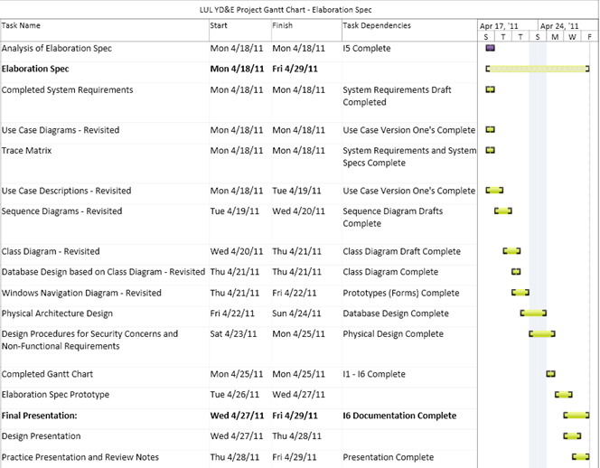
Final Step: GANTT CHART

